Slide 1


Amazon OpsWorks. Deployment with ease.
Pacemaker: LAMP
by Petro Sasnyk, Tech Lead Softserve Inc.
@stoune,
stoune

Slide 2
agenda
Why do I need automated deployment
Why should I use Amazon OpsWorks
How to use Amazon OpsWorks real-world scenario

Slide 3
Why do I need automated deployment?

Slide 4
Why do I need to avoid manual deployment?
Because it is boring
Because it is cumbersome
Because it error-prone
Because it takes a lot of time
Because it is not repetitive
Because it is not scalable
Because …
Or
Continue doing monkey job

Slide 5
AND…

Slide 6
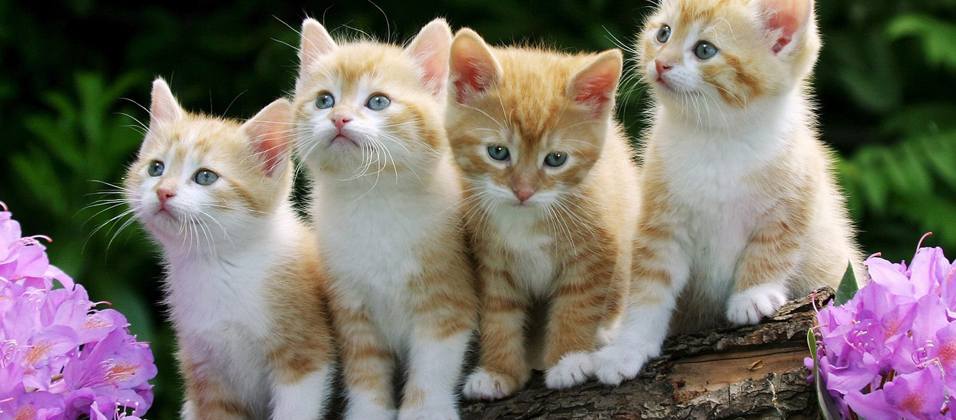
Every time you deploy manually, god kills a kitten
Please think of the kittens

Slide 7
Modern web application characteristics

Slide 8
The twelve-factor app by heroku
I. Codebase - One codebase tracked in revision control, many deploys
II. Dependencies - Explicitly declare and isolate dependencies
III. Config - Store config in the environment
IV. Backing Services - Treat backing services as attached resources
V. Build, release, run - Strictly separate build and run stages
VII. Port binding - Export services via port binding
IX. Disposability - Maximize robustness with fast startup and graceful shutdown
X. Dev/prod parity - Keep development, staging, and production as similar as possible
XII. Admin processes - Run admin/management tasks as one-off processes

Slide 9
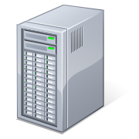
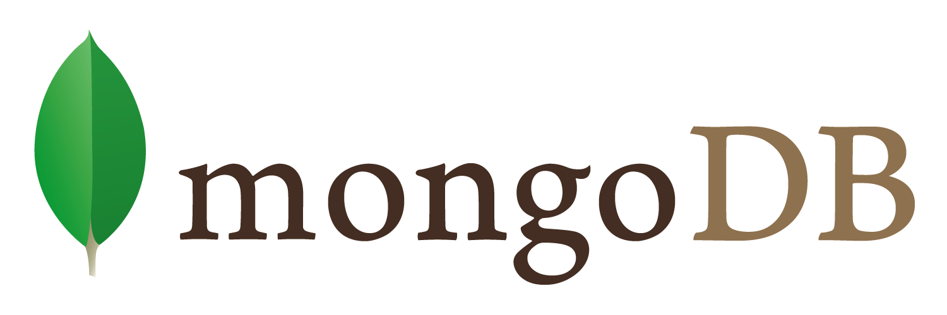
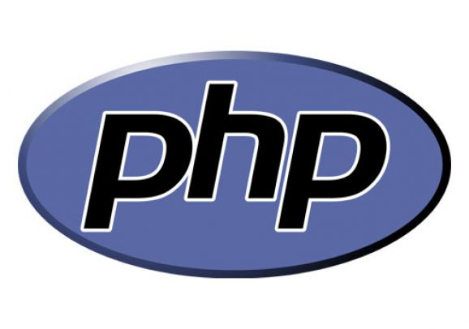
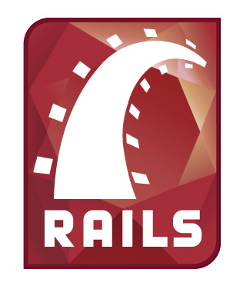
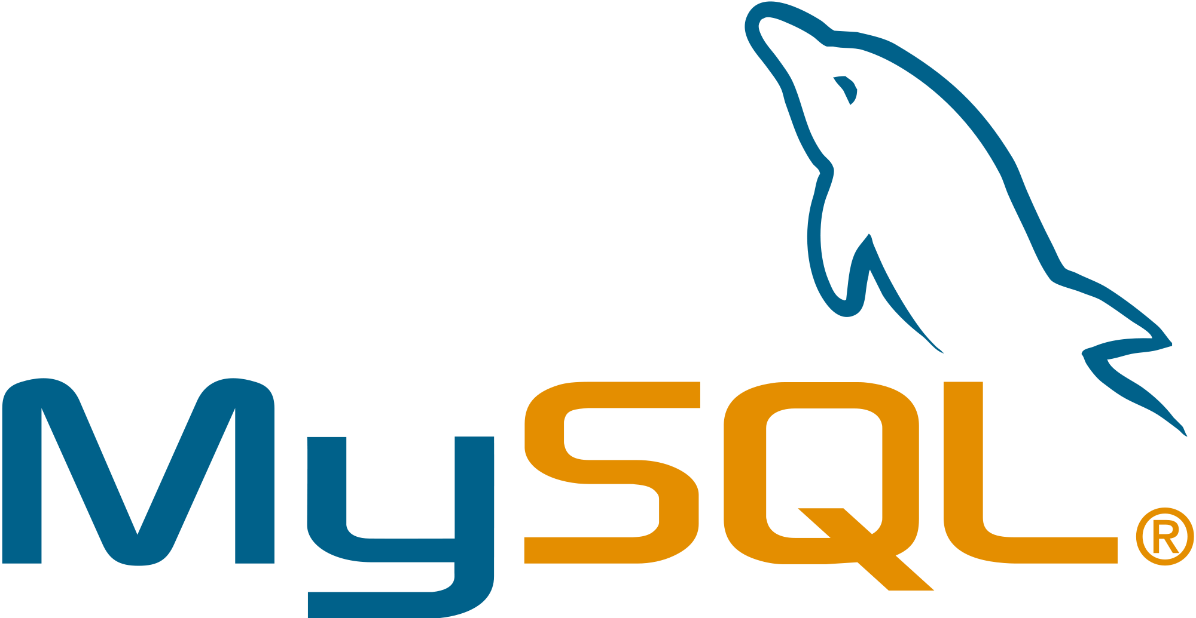
Amazon opsworks solution
Stack
Layers
Instances
Stack is basically a container for a set of Amazon EC2 instances (with related resources) that have a common purpose or should be logically managed as a group
A Layer defines how to set up and configure a set of instances and related resources
Instances are running your code according to layer specification. You define how you are going to scale
Then you make a deployment to specific instances and customize the deployment with Chef recipes

Slide 10
5 steps to start using opsworks and to loose your sleep ☺

Slide 11
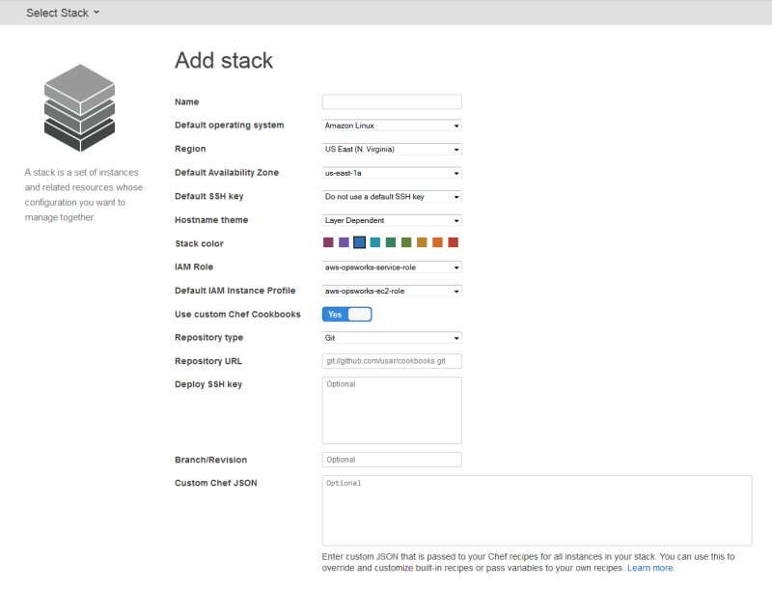
Step 1. create a stack
Name
OS (Amazon linux or Ubuntu lts)
Region
Do not forget to use your favorite pink color to mark the stack ☺

Slide 12
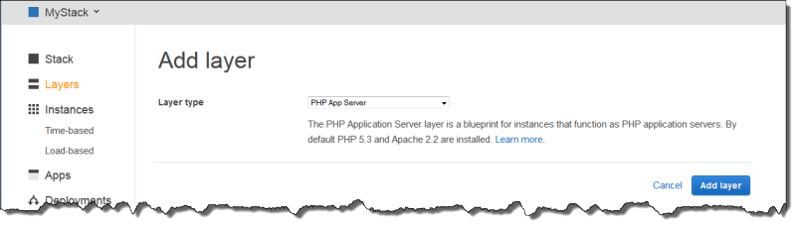
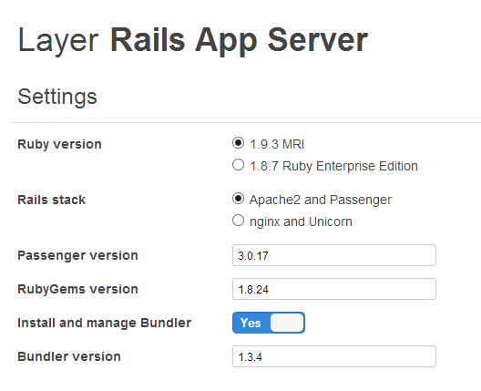
Step 2. Add layer
Type
Select components versions (for rails: ruby, gemset, bundler, phusion passenger or unicorn)
Additional settings

Slide 13
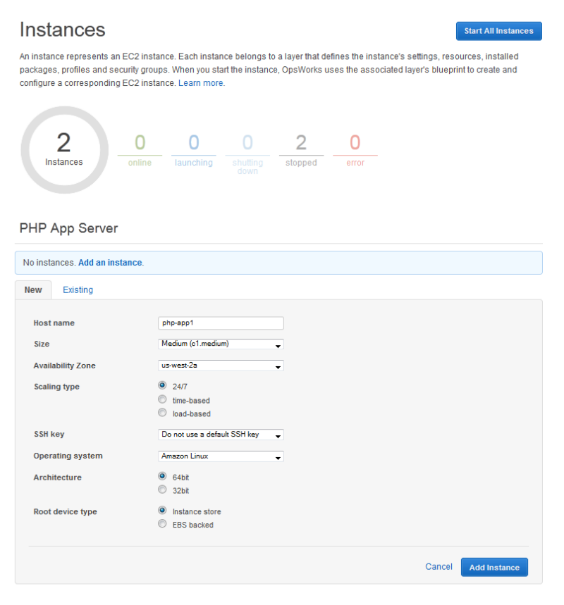
Step 3. Add instance
Name
size
Availability zone
Scaling type (24/7, Time-based, load-based)
OS

Slide 14
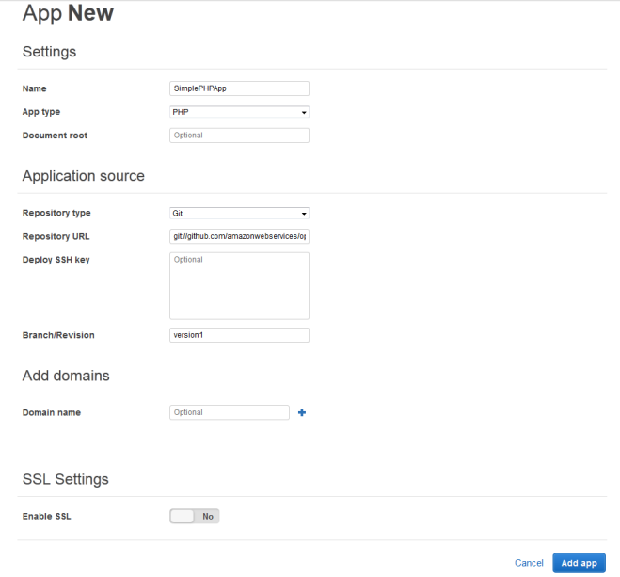
Step 4. create an app
name
type
scm

Slide 15
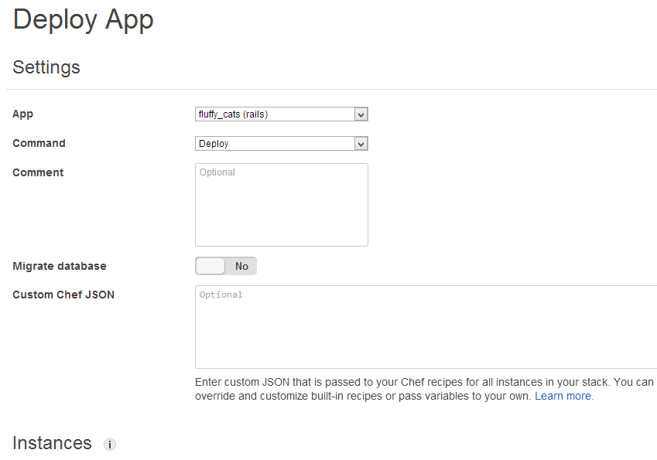
Step 5. deploy an app
Command
Advanced: Target instances
Advanced: Chef json

Slide 16
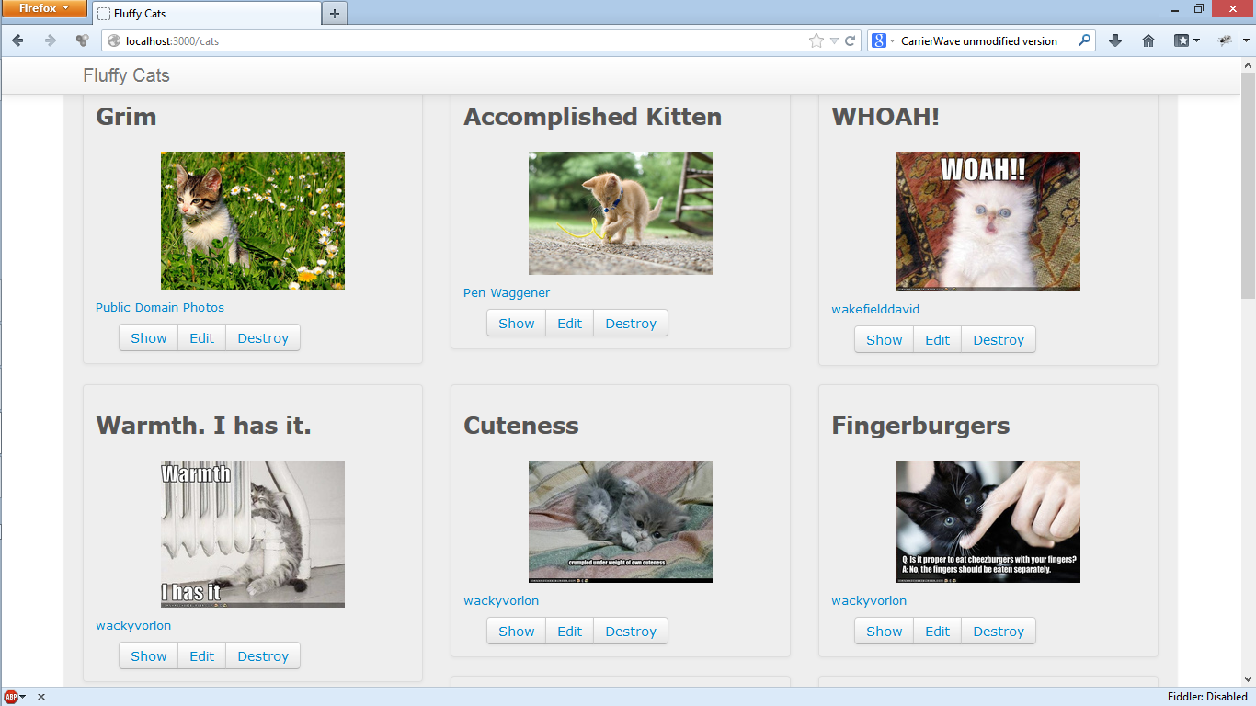
Review results
If you are lucky, you will see your app

Slide 17
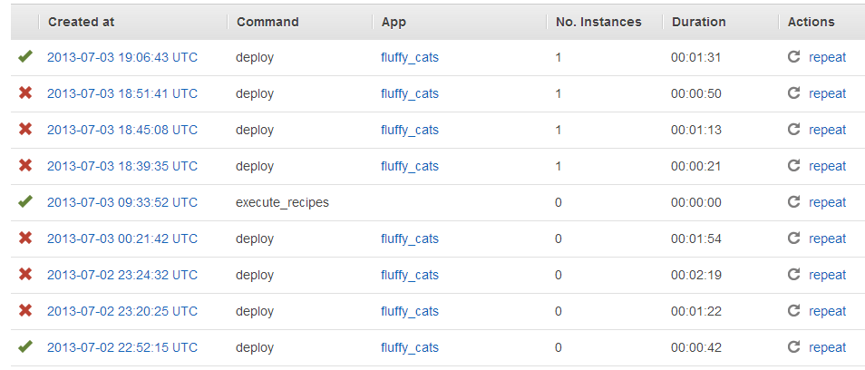
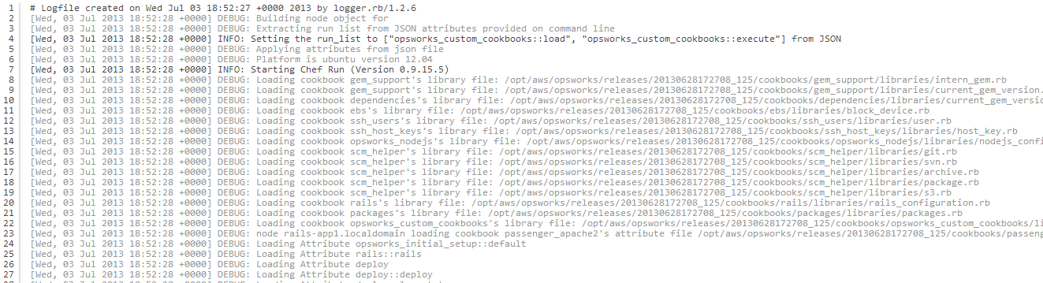
Review result
If not…
Have a happy debugging

Slide 18
fluffy cats application
This is the next billion-dollar business. The coolest site ever about fluffy cats. Isn’t it cute?

Slide 19
fluffy cats application: architecture
Amazon RDS/MySQL Database
Elastic Load Balancer
Rails App Server
Amazon S3/File storage
Me – The user

Slide 20
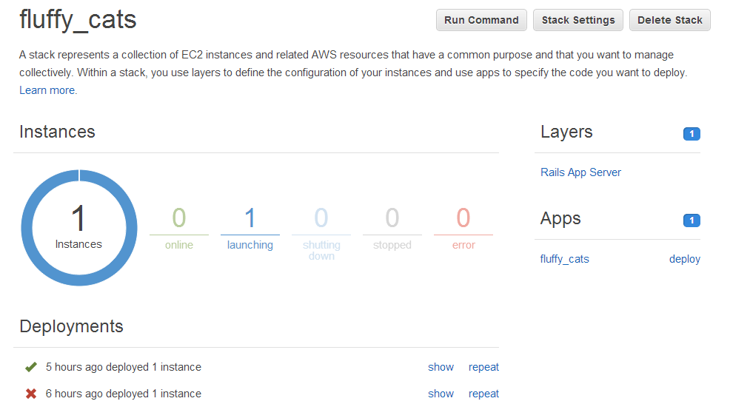
Fluffy cats opsworks console
The demo

Slide 21
alternatives
Heroku/Fully managed PaaS
OpsWorks
Cheff/Puppet
+ IaaS
Elastic BeansTalk
CloudFormation
Lower complexity/
Lower flexibility
Higher complexity/
Higher flexibility

Slide 22
Pitfalls
Vendor lock-in (who cares)
It’s still beta (bugs, small expertise, etc.)
To make complicated things, you need to learn Ruby and chef
Amazon OpsWorks uses chef solo 0.7, latest version is 0.11.0
A lot of cookbooks and recipes are incompatible with Amazon opsworks

Slide 23
Conclusions
Use good instruments for Great Good
Use automated deployments (or your architect will punish you)
Amazon opsworks could simplify your deployment tasks or may not

Slide 24

Still have Questions?
Do not ask questions, just go and register
your free Amazon account and taste the red pill

Slide 25
Useful links
Fluffy Cats application source code: https://github.com/stoune/fluffy_cats.git
Fluffy Cats Custom Chef Cookbooks: https://github.com/stoune/fluffy_cats_cookbooks.git
The twelve factor app
Amazon opsworks user guide
Opscode docs

Slide 26

Thank you!
Now run for your free cookies

